Slide 1
Hyper-V 2012
Paul Singh
Technical Solutions Professional - Datacenter
Core Infrastructure - EDU
Microsoft

Slide 2
Session Objectives
Overview of Features of Hyper-V and Windows Server 2012
    Compute, Storage and Networking
    Scalability
    Disaster Recovery
    Security

Slide 3




Why Hyper-V 2012?
Scalability, Performance & Density
Secure Multitenancy
Flexible Infrastructure
High Availability & Resiliency

Slide 4
Hyper-V History
Hyper-V Server 2012 launched
Windows Server 2008 R2 Hyper-V & Hyper-V Server 2008 R2 launched
Hyper-V Server 2008 launched
SP1 for Windows Server 2008 R2 & Hyper-V Server 2008 R2 launched
Live Migration
Cluster Shared Volumes
Processor Compatibility
Hot-Add Storage
Performance & Scalability Improvements
Dynamic Memory
RemoteFX
October 2008
October 2009
February 2011
September 2012

Slide 5
Enterprise Class Hypervisor
Scale
Live Migration should just work
  Scale isn’t just more virtual processors
  No tradeoffs
Performance must increase with cores
Virtualize workloads considered “non-virtualizable”
  Maximize your investment
  Let’s build the best cloud together

Slide 6
Hyper-V Scalability Improvements
“Nothing from Microsoft, and I mean literally nothing has ever been this ambitious”
System | Resource | Windows Server 2008 R2 Hyper-V | Windows Server 2012 Hyper-V | Improvement Factor
Host | Logical Processors | 64 | 320 | 5×
 | Physical Memory | 1TB | 4TB | 4×
 | Virtual CPUs per Host | 512 | 2,048 | 4×
VM | Virtual CPUs per VM | 4 | 64 | 16×
 | Memory per VM | 64GB | 1TB | 16×
 | Active VMs per Host | 384 | 1,024 | 2.7×
 | Guest NUMA | No | Yes | -
Cluster | Maximum Nodes | 16 | 64 | 4×
 | Maximum VMs | 1,000 | 8,000 | 8×
— Jason Perlow, ZDNet

Slide 7
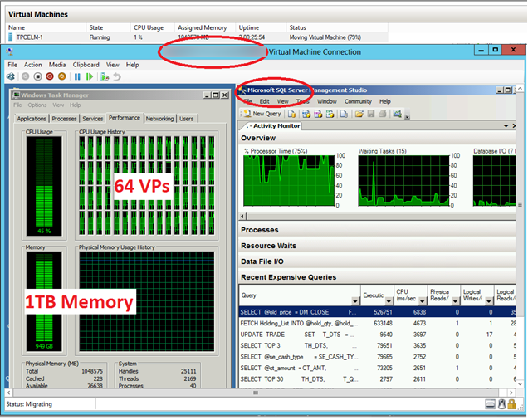
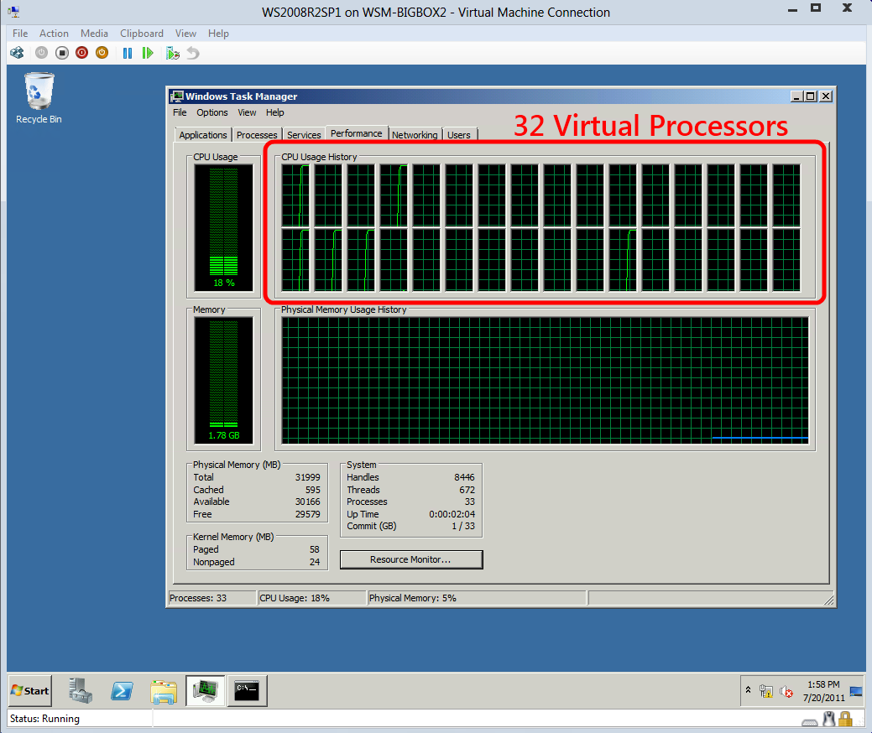
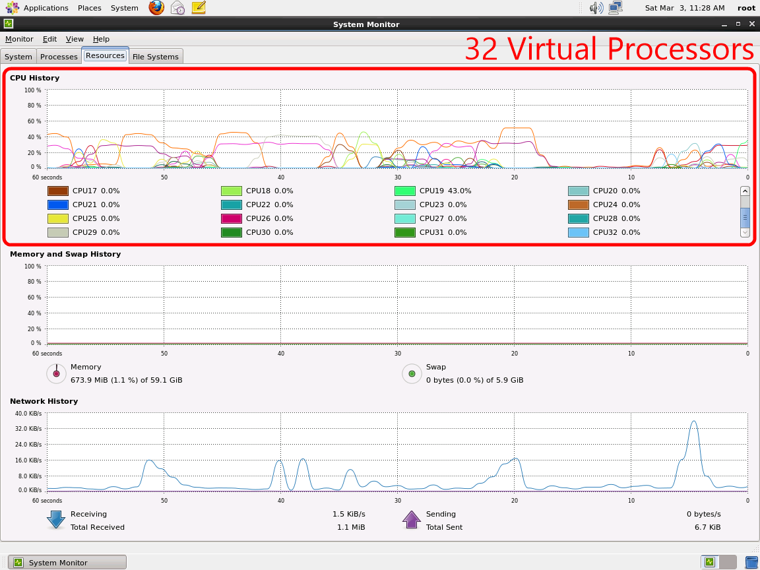
Hyper-V Scale Comparison
Massive Scale in the Box
 | Windows Server 2008 | Windows Server 2008 R2 | Windows Server 2012
HW Logical Processor Support | 16 LPs | 64 LPs | 320 LPs
Physical Memory Support | 1 TB | 1 TB | 4 TB
Cluster Scale | 16 Nodes up to 1000 VMs | 16 Nodes up to 1000 VMs | 64 Nodes up to 4000 VMs
Virtual Machine Processor Support | Up to 4 VPs | Up to 4 VPs | Up to 64 VPs
VM Memory | Up to 64 GB | Up to 64 GB | Up to 1 TB
Live Migration | Yes, one at a time | Yes, one at a time | Yes, with no limits. As many as hardware will allow.
Live Storage Migration | No. Quick Storage Migration via SCVMM | No. Quick Storage Migration via SCVMM | Yes, with no limits. As many as hardware will allow.
Servers in a Cluster | 16 | 16 | 64
VP:LP Ratio | 8:1 | 8:1 for Server 12:1 for Client (VDI) | No limits. As many as hardware will allow.

Slide 8

Scaling up: Physical NUMA
NUMA node 1
NUMA node 2
NUMA (Non-uniform memory access)
  Helps hosts scale up the number of cores and memory access
  Partitions cores and memory into “nodes”
  Allocation and latency depends on the memory location relative to a processor
High performance applications detect NUMA and minimize cross-node memory access
Processors
Memory
Host NUMA

Slide 9
Scaling up: Physical NUMA
NUMA node 1
NUMA node 2
Processors
Optimized -
  Memory allocation and thread allocations within the same NUMA node
  Memory populated in each NUMA node
Memory
NUMA node 3
NUMA node 4
Processors
Memory
Host NUMA

Slide 10
Scaling up: Physical NUMA
NUMA node 1
NUMA node 2
Processors
This isn’t optimal…
  System is imbalanced
  Memory allocation and thread allocations across different NUMA nodes
  Multiple node hops
  NUMA Node 2 has an odd number of DIMMS
  NUMA Node 3 doesn’t have enough
  NUMA Node 4 has no local memory (worst case)
Memory
NUMA node 3
NUMA node 4
Processors
Memory
Host NUMA

Slide 11

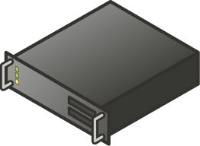
Scaling Up: Guest NUMA
Guest NUMA (For VMs)
  Presenting NUMA topology within VM
  Guest operating systems & apps can make intelligent NUMA decisions about thread and memory allocation
Guest NUMA nodes are aligned with host resources
vNUMA node A
vNUMA node B
vNUMA node A
vNUMA node B
NUMA node 1
NUMA node 2
NUMA node 3
NUMA node 4

Slide 12
Hyper-V Storage

Slide 13
Dynamic, High Performance Storage
Live Storage Migration
Shared Nothing Live Migration
Support for File Based Storage on SMB 3.0
New VHDX Format
Online MetaOperations
  Live VHD Merge

Slide 14
Enhanced Storage Capabilities
Offloaded Data Transfer
Offloads storage-intensive tasks to the SAN
Virtual Fibre Channel
Connect a VM directly to FC SAN without sacrificing features
Native 4KB Disk Support
Take advantage of enhanced density and reliability
64TB Virtual Hard Disks
Increased capacity, protection & alignment optimization

Slide 15
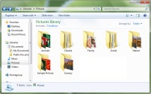

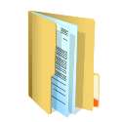

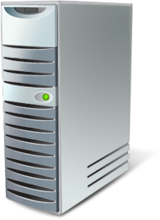
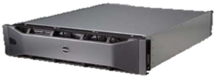

Offloaded Data Transfer (ODX)
Offload Read
Offload Write
Virtual Disk
Actual Data Transfer
Virtual Disk
Intelligent Storage Array

Slide 16
Hyper-V ODX Support
Secure Offload data transfer
  Fixed VHD/VHDX Creation
  Dynamic VHD/VHDX Expansion
  VHD/VHDX Merge
  Live Storage Migration
Just one example…
~3 Minutes
<1 Second!

Slide 17
Hyper-V Networking

Slide 18
Windows Server 2012 Networking: It’s All There
Feature rich, extensible, in the box, no compromises
 | Windows Server 2008 | Windows Server 2008 R2 | Windows Server 2012
NIC Teaming | Yes, via partners | Yes, via partners | Windows NIC Teaming in box.
VLAN Tagging | Yes | Yes | Yes
MAC Spoofing Protection | No | Yes, with R2 SP1 | Yes
ARP Spoofing Protection | No | Yes, with R2 SP1 | Yes
SR-IOV Networking | No | No | Yes
Network QoS | No | No | Yes
Network Metering | No | No | Yes
Network Monitor Modes | No | No | Yes
IPsec Task Offload | No | No | Yes
VM Trunk Mode | No | No | Yes

Slide 19
Hyper-V Extensible Switch
Hyper-V Extensible Switch is an open platform that lets multiple vendors provide extensions that are written to
standard Windows API frameworks
Cisco
Nexus 1000V
Multiple Partner Extensions
Packet Inspection
5nine
Security Manager
Packet Filtering
NEC
OpenFlow
InMon
sFlow
Network Forwarding
Intrusion Detection

Slide 20
Networking Performance
Dynamic
VMq
Dynamically span multiple CPUs when processing
virtual machine network traffic
IPsec Task Offload
Offload IPsec processing from within virtual machine,
to physical network adaptor, enhancing performance
SR-IOV Support
Map virtual function of an SR-IOV capable physical network adaptor, directly to a virtual machine

Slide 21
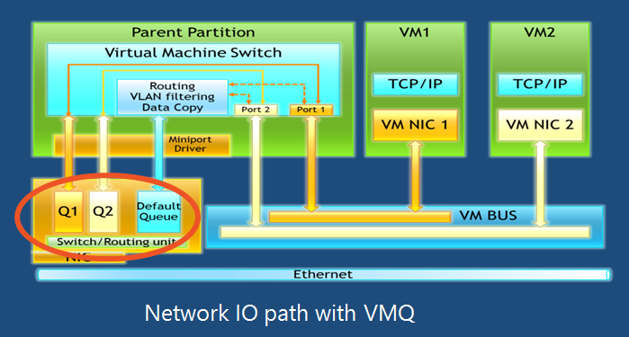
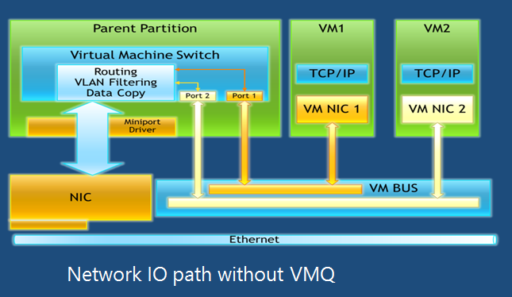
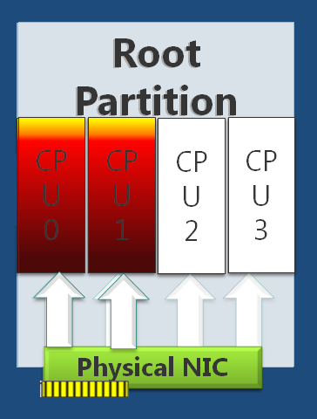
VMQ

Slide 22
Single-Root I/O Virtualization
(SR-IOV)
Reduces latency of network path
Reduces CPU utilization for processing network traffic
Increases throughput
Direct device assignment to virtual machines without compromising flexibility
Supports Live Migration
Root Partition
Virtual Machine
Hyper-V Switch
Virtual NIC
Routing
VLAN Filtering
Data Copy
VMBUS
Virtual Function
Physical NIC
SR-IOV Physical NIC
Network I/O path without SR-IOV
Network I/O path with SR-IOV

Slide 23
Multi-Tenant Network Requirements
A college wants to easily move VMs to/from the cloud
DC Site Admins wants to place VMs anywhere in the data center
Both want: Easy Onboarding, Flexibility & Isolation
North College
Blue 10.1.0.0/16
Cloud Data Center
East College
Red 10.1.0.0/16

Slide 24

Guest Fibre Channel Architecture
Up to four virtual HBAs assigned to each VM
WWNs assigned to each VM
Doesn’t require re-zoning
Works with Live Migration

Slide 25
Hyper-V Resource Management and DR

Slide 26
Enhanced Resource Management
Dynamic Memory
Increased control for greater virtual machine consolidation
Resource Metering
Track historical data for virtual machine usage
Quality of Service (QoS)
Consistent level of performance based on SLAs
Data Center Bridging
Converge network traffic to provide enhanced QoS

Slide 27

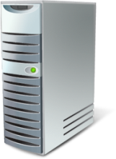

Hyper-V Replica
VM Replication
Disaster Recovery Scenarios:
  Planned, Unplanned and Test Failover
  Pre-configuration for IP settings for primary/remote location
Key Features:
  RPO/RTO in minutes
  Seamless integration with Hyper-V and Clustering
  Automatically handles all VM mobility scenarios (e.g. Live migration)
  Supports heterogonous storage between primary and recovery
  Integrates with Volume Shadow Services (VSS)

Slide 28
Demo
Hyper-V Replica
- Replication between two physical hosts.
Environment:
2 Physical Servers: HP ProLiant SE316M1
  - 72 GBs of RAM, 820 GBs storage
  - Microsoft Windows Server 2012 Datacenter

Slide 29
Key Hyper-V Replica Takeaways
Easy to Setup
  Via wizard
  Or, via PowerShell
Works with your current hardware
All you need is two connected servers running Windows Server 2012
No Guest Dependencies

Slide 30
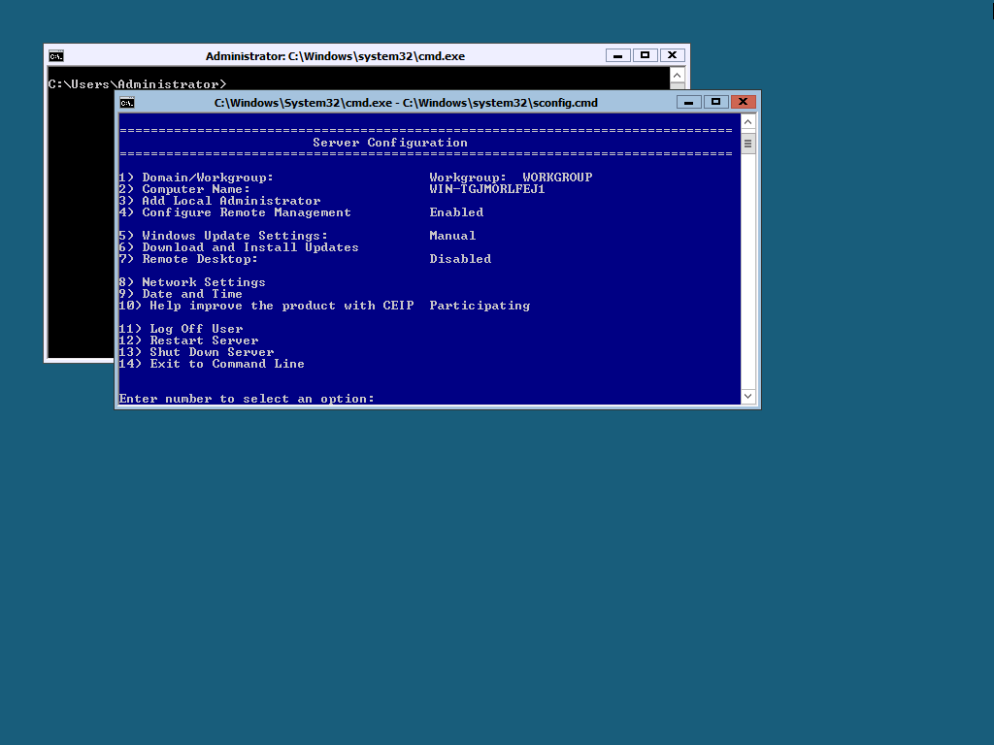
What is Microsoft Hyper-V Server?
Enterprise-class, Microsoft hypervisor
  Local Command Line Interface
  Does not include guest OS licenses
Standalone Hyper-V
Free ISO download from Microsoft.com website
Designed for remote management
Contains all Hyper-V features

Slide 31
Hyper-V
VDI & Client

Slide 32
Virtual Desktop Infrastructure
Remote Desktop Services Built-In
One platform, one experience, 3 deployment choices
Unified Management
Sessions, desktops, users & apps from a single console
Intelligent Patching
Automated patching for pooled virtual desktops
RemoteFX across LAN & WAN
Consistently rich experience with H/W or S/W GPU

Slide 33
Great Reasons to use Hyper-V Server
Linux VM Consolidation
VDI platform
Hoster virtualization platform

Slide 34
Client Hyper-V
Windows 8
  SLAT capable processor required

Slide 35
Hyper-V Security

Slide 36
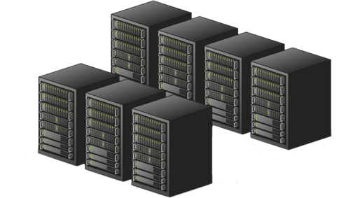




Security
In a multi-tenant environment …
… customers want security and isolation
Tenant 1: Multiple VM Workloads
Tenant 2: Multiple VM Workloads
Data Center

Slide 37
Physical Security
BitLocker ensures your data stays secure, even when your Hyper-V hosts, clusters, and storage reside in less-physically-secure locations
BitLocker
Local Disk
Traditional Cluster Disk
CSV 2.0

Slide 38



Critical Safeguard for the Cloud
Encrypted cluster volumes
BitLocker encrypted cluster disks
  Support for traditional failover disks
  Support for Cluster Shared Volumes
Cluster Name Object (CNO) identity used to lock and unlock Clustered volumes
Enables physical security for deployments outside of secure datacenters
  Branch office deployments
Volume level encryption for compliance requirements
Negligible (<1%) performance impact

Slide 39
Complete Redundancy In the Box
  Hyper-V Replica for Asynchronous Replication
  CSV 2.0 Integration with Storage Arrays for Synchronous Replication
Disaster Recovery
  Non-Cluster Aware Apps: Hyper-V App Monitoring
  VM Guest Cluster: iSCSI, Fiber Channel
  VM Guest Teaming of SR-IOV NICs
Application/Service Failover
  Network Load Balancing & Failover via Windows NIC Teaming
  Storage Multi-Path IO (MPIO)
  Multi-Channel SMB
I/O Redundancy
  Live Migration for Planned Downtime
  Failover Cluster for Unplanned Downtime
Physical Node Redundancy
Hardware Fault
  Windows Hardware Error Architecture (WHEA)

Slide 40
Capability Review
Capability | Windows Server 2012 Hyper-V
Incremental Backups | Yes
VM Replication | Yes
NIC Teaming | Yes
Integrated High Availability | Yes
Failover Prioritization | Yes
Affinity & Anti-Affinity Rules | Yes
Cluster-Aware Updating | Yes

Slide 41
Capability Review
Capability | Windows Server 2012 Hyper-V
Dynamic Virtual Machine Queue | Yes
IPsec Task Offload | Yes
SR-IOV with Live Migration | Yes
Storage Encryption | Yes
No restrictions such as a distributed switch are imposed when using SR-IOV in Hyper-V, ensuring customers can combine the highest levels of performance with the flexibility they need for an agile infrastructure.

Slide 42
In Review: Session Objectives and Takeaways
Hyper-V 2012 Overview
  Compute, Storage and Networking
Unparalleled VM Mobility and Security
Disaster Recovery

Slide 43
Free Hyper-V 2012 Training/
Resources
Microsoft Virtual Academy
  Introduction to Hyper-V Jump Start
  Microsoft Virtualization for VMware Professionals Jump Start
Microsoft Tools for VMware Integration & Migration
Microsoft Virtual Machine Converter

Slide 44

Q & A
© 2013 Microsoft Corporation. All rights reserved. Microsoft, Windows, Windows Vista and other product names are or may be registered trademarks and/or trademarks in the U.S. and/or other countries.
The information herein is for informational purposes only and represents the current view of Microsoft Corporation as of the date of this presentation. Because Microsoft must respond to changing market conditions, it should not be interpreted to be a commitment on the part of Microsoft, and Microsoft cannot guarantee the accuracy of any information provided after the date of this presentation. MICROSOFT MAKES NO WARRANTIES, EXPRESS, IMPLIED OR STATUTORY, AS TO THE INFORMATION IN THIS PRESENTATION.

