Slide 1
Improving Critical Thinking for Phishing Targeted Users Beth Sallay M. Ed bs11@utah.edu

Slide 2
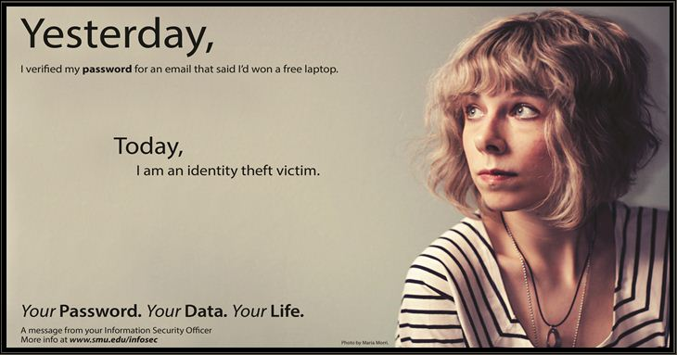
Notes:
Southern Methodist University; security awareness campaign, image works for drugs, alcohol, daterape, cheating

Slide 3
Are users:
On autopilot?
Not engaged or passive in their online activities?
Cowed by perceived authority?
Lacking critical thinking abilities?
Other?

Slide 4
Phishing
Scamming method used to elicit information from uninformed computer users through impersonation of trusted sources; respelling of fishing used to evade scans and filters by mainstream servers policing the internet.
Notes:
Technical side and a user side.
Phishing and malware have a similar delivery system.

Slide 5
Malware
Any code, program, script, software or any instructions interpreted as attacking a computer operating system. Malware includes spyware, trojans, viruses denial of service/DoS attacks.
Notes:
Delivery is similar to phishing

Slide 6
Delivery: email message
Mimicry: appearance of a legit site
Goal: click link/reply and enter desired info: cc#, username and password, etc.

Slide 7
Email Messages will contain:
Threats
Company Logo or Name
Links
+/- misspelled words and typos

Slide 8
Subject: Faculty / Staff / Student Mail Warning Notification !
Mail account compromised, Confirm and verify your account by clicking Mailbox Verification .
IMPORTANT NOTICE: Current Mailbox Quota-size:95.6% You will not be able to send and receive email messages at 98.8% quota size.
Admin Help-desk
© Copyright 2013
Notes:
Example from last friday

Slide 9
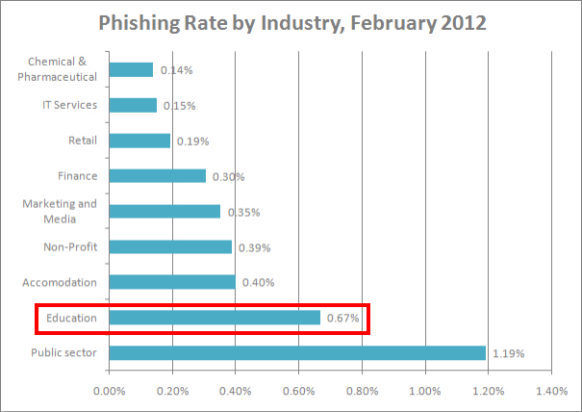
Notes:
We are the #2 most phished industry from Symantec

Slide 10
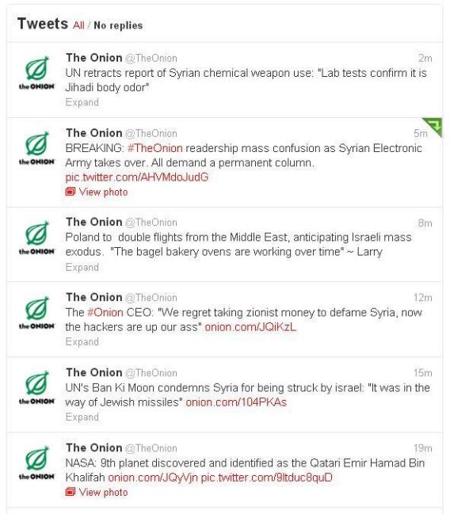
Notes:
The onion was hacked on twitter by the syrian electronic army

Slide 11
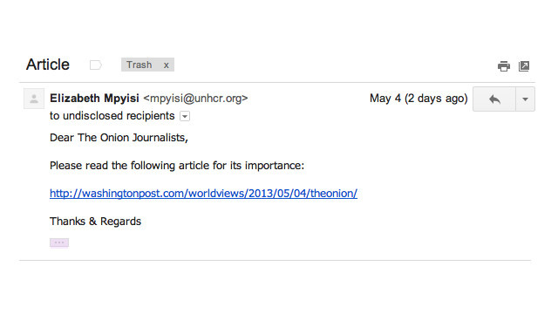
Notes:
How the onion was hacked

Slide 12
Emotional Triggers Exploited by Phishing
Greed
Fear
Heroism
Desire to be Liked
Authority

Slide 13
Greed
Date: Mon, 5 Jan 2004 09:30:13 From: chika_williams@tiscali.co.uk To: gullible@yahoo.com Subject: URGENT RE: URGENT REQUEST FOR YOUR UNALLOYED CO-OPERATION TO TRANSFER (US$20.4 MILLION U.S. DOLLARS ONLY) INTO YOUR PRIVATE OR COMPANY’S ACCOUNT

Slide 14
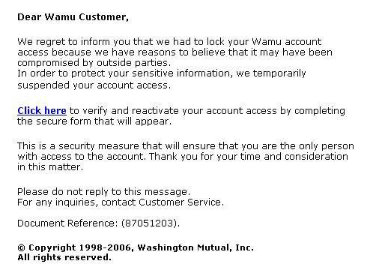
Fear/Authority

Slide 15
Heroism/Desire to be Liked

Slide 16
Victim Personality Traits
Neurotic
Impulsive
Introverted
Notes:
Cognitive bias, pretty common
People are not good at estimating their vulnerability to internet attack.
Neuroticism causes people to be more upset at when being lied to and prefer to believe people are more truthful
Impulsive – click as fast as possible, once clicked they are probably going to commit to the rest
Introversion – prefer online communication

Slide 17
Cognitive Bias
We are bad at detecting deception in others but good at detecting honesty.
We tend to overestimate our abilities and underestimate risk.
We believe what we want to believe (cognitive dissonance).

Slide 18
Commitment Issues:
If they click on the link they are more likely to do what they are asked (give up their personal info).
*If their browser doesn’t warn them.

Slide 19
Research Study (2008)
Undergrads in Intro to Information Systems were given a Super Secret Code.
‘DO NOT GIVE OUT YOUR SSC’
Notes:
The SSC was printed on official university letterhead with the title disclaimer “Do Not Disclose This Code.”
SSC was used to access grades, quizzes, professor/ta email info: SSC is important and private.
Giving it out would affect grades and violate the student conduct code. A nondisclosure agreement was signed.

Slide 20
8 Weeks of internet security instruction on phishing, hacking and internet security.
All lectures began with reminder displayed on PowerPoint:
‘DO NOT GIVE OUT YOUR SSC’
Week 6: The unexpected, but not really.
Notes:
Week 6: a real, unplanned phishing attack with IT warning students, written up in student paper.

Slide 21
Week 8:
From: Jason Roth Database Administrator
This e‑mail is to inform you of a problem we are having with the information technology database. Due to a data collision we have lost some information and are unable to recover it. In order to get the database back up and working we need you to forward us your “super-secure code.” Please respond to this e‑mail with your code. Sorry for the inconvenience.
Notes:
No links, no company logo.
The goal: don’t respond to this, report it to Campus IT

Slide 22
Out of 299 [final] participants:
57% ignored (170)
32% replied with SSC (97)
9% alerted IT (26)
1% responded with a question/comment (4)
<1% responded with incorrect info (2)
Notes:
Started with 446
147 subjects were excluded:
Dropped class
Didn’t receive the email/couldn’t find it
Didn’t take the post instruction test
Didn’t complete all items on final survey

Slide 23
here is my SSC xxxxxx. I hope that the database will get fixed very soon. Best of luck to you on fixing the database.
My Network ID is xxxxx, My Student Number is xxxxx, my super secure Code is xxxxx, my home number is xxxxx.
I think this is my code: xxxx, but I’m not sure. you can call my mom at xxx- xxxx if this isn’t it as she will have it for you.
I was told to never give out my super secrete (sic) code. . . . So how do I know this isn’t a scam?
I’m sorry to hear about your problems, but I will not be able to assist you.
Notes:
The responses

Slide 24
Research Study (West Point 2004)
Security Emergency Response Team
First to be certified by the NSA as a CAEIAE: Center of Academic Excellence in Information Assurance Education (IT Security)
SAT scores in the top 25%
Security awareness training at the beginning of each semester.
Notes:
4 page educause article on a study done at West Point: average sat score in the top 25%
Center of Academic Excellence in Information Assurance Education (IT Security)
No discussion on ongoing IT security training

Slide 25
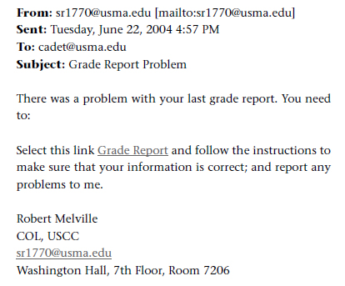
Notes:
Sent to 512 cadets
Link returned a 404 error but might have had more results if presented w a login screen.

Slide 26
Results: Out of 512 cadets:
80% clicked the link (~400)
Notes:
There was no mention of an actual phishing attempt near this test.

Slide 27
Reasons
‘The email looked suspicious but it was from an Army colonel so I figured it must be legitimate.’
‘Any e-mail that contains the word ‘grade’ in it gets my immediate attention and action!’

Slide 28
Data Analysis
Experience Factors:
Lack of Computer self confidence
Lack of Web experience
Lack of Security policy knowledge
Personality Factors
Victim personality traits (neurotic, impulsive, introverted)
Phishing and Social Engineering works better on naive and vulnerable users.
Notes:
From both studies

Slide 29
What Made the Difference?
Reinforced and Ongoing Trainings
Security Awareness
Communication from IT on Actual Phishing Attacks
Notes:
Disposition to trust
Perceived risk
Did not matter

Slide 30
Are users:
On autopilot? no
Not engaged or passive in their online activities? no
Cowed by perceived authority? A bit
Lacking critical thinking abilities? No
Other? yes
Notes:
Users were engaging in their online activities and thinking critically about them.

Slide 31
IT Managers
Be aware of potential victim users:
Oversharing on Facebook (content and quality)
New to the web
Victim Personality Traits
Talk about it:
my personal story
Educate Users:
Training on the Difference Between Phishing, Malware and Spam.
Notes:
My mom used to respond to spam asking them to stop emailing her.
I have a instructor led power point training on phishing, malware and spam and plan to do a captivate video. Will be on the wiki

Slide 32
From the Help Desk
Subject: New #1 call... or why trying to maintain computer security is a losing battle.

Slide 33
Recommended Articles
The Influence of Experiential and Dispositional Factors in Phishing: An Empirical Investigation of the Deceived
Journal of management information systems [0742-1222] Wright, Ryan yr:2010 vol:27 iss:1 pg:273 -303
An Investigation of Heuristics of Human Judgment in Detecting Deception and Potential Implications in Countering Social Engineering
2007 IEEE Intelligence and Security Informatics Tiantian Qi, Tiantian yr:2007 pg:152 -159
Fostering E-Mail Security Awareness: The West Point Carronade
EDUCAUSE quarterly [1528-5324] Ferguson, Aaron yr:2005 vol:28 iss:1 pg:54 -57
The State of Phishing Attacks
Communications of the ACM [0001-0782] Hong, Jason yr:2012 vol:55 iss:1 pg:74 -81
Phishing, Personality Traits and Facebook
Halevi, Tzipora yr:2013
Telling Lies: Clues to Deceit in the Marketplace, Politics, and Marriage
Paul Ekman; c1985 New York : Norton

Slide 34
Questions??
bs11@utah.edu

