Slide 1
IPv6 Address Planning
Tom Coffeen, Chief IPv6 Evangelist
UEN Technical Summit 2013

Slide 2
IPv6 Address Planning
Why you need an IPv6 addressing plan...

Slide 3
IPv6 Address Planning
It’s a substantial step toward deploying IPv6 with:
Few prerequisites
Little if any cost to an organization
Zero impact to the existing network or current addressing scheme
A great dividend of IPv6 knowledge and confidence given the modest time and effort required

Slide 4
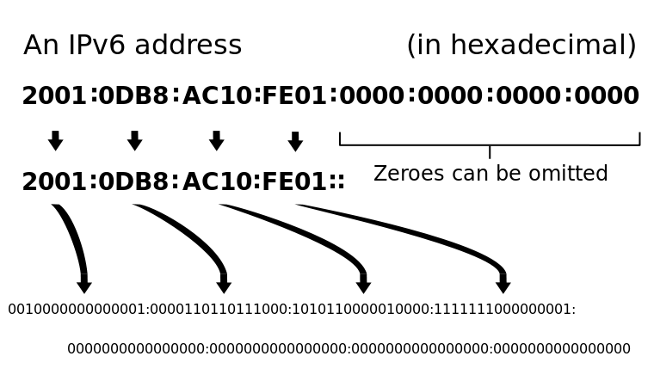
IPv6 Address Planning

Slide 5
IPv6 Address Planning
2001:db8:ac10:fe01::/64

Slide 6
IPv6 Address Planning

Slide 7

Get Your IPv6 Addresses
Small and medium companies with a single ISP will get Provider-Aggregatable(PA) IPv6 addresses from the ISP
Large organizations that are multi-homed to multiple ISPs, have their own ASN, and have public IPv4 addresses can qualify to get Provider-Independent (PI) IPv6 addresses from their RIR
# of ISPs
=1
>1
PA IPv6 Addresses from ISP
PI IPv6 Addresses from RIR

Slide 8
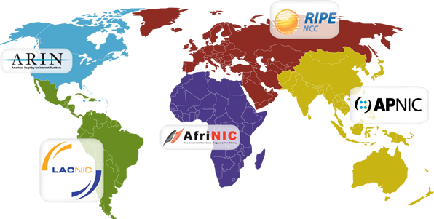
Get Your IPv6 Addresses
AFRINIC: http://www.afrinic.net/index.php/en/services/registration-services
APNIC: http://www.apnic.net/services/apply-for-resources/kickstart-your-ipv6
ARIN: https://www.arin.net/resources/request/ipv6_initial_assign.html
LACNIC: http://lacnic.net/en/registro/ipv6-endusers.html
RIPE: http://www.ripe.net/lir-services/resource-management/number-resources/ipv6

Slide 9

IPv6 Address Planning
Eliminating “IPv4 thinking”
  VLSM/CIDR…obsolete with IPv6
  “How many hosts on a segment?”…no longer a relevant question
Conservation of address space
Conservation of router CPU and memory (DFZ size)

Slide 10
IPv6 Address Planning
One /48 per site, one /64 per interface
    /127 for point-to-point (reserve a /64 per point-to-point link)
    /128 for loopback (all loopbacks for a single routing domain can come from one /64)
    /120-/126 HSRP/VRRP

Slide 11
IPv6 Address Planning
What constitutes a site? Nearly anything you decide does
  Geographical regions, campus LANs, data centers, buildings, remote sites, even CPE devices
  Most important consideration: operational efficiency
  Not enough /48s? Back to the RIR or ISP
How many /48s are there anyhow?
2⁴⁵ = 35,184,372,088,832
2000::/3 = 15% of 2¹²⁸

Slide 12
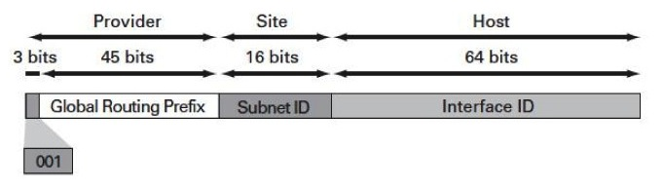
IPv6 Address Planning
An IPv6 allocation contains both fixed and flexible bits:
  In a /48 allocation, the high-order 48 bits are reserved as a network identifier; i.e. the Global Unicast Prefix
  The Interface ID is the low-order 64 bits reserved for host addressing
    This bit boundary preserves critical behavior such as SLAAC as well as ease of administration

Slide 13
IPv6 Address Planning
Try to stick to the nibble (4 bit) boundary…
Makes prefixes more readable and improves operational efficiencies
Unallocated bits in between the boundaries can be reserved for future growth
Smallest available set for assigned meaning is 16

Slide 14
IPv6 Address Planning
The flexible bits of an IPv6 allocation can convey organizational significance, such as:
geographical location
host function

Slide 15
IPv6 Address Planning
Encoding location first makes prefix aggregation easier:
Allocation from RIR: 2001:db8:abcd::/48
2001:db8:1234:abcd::/52
Location: 4 bits = 16 locations
2001:db8:1234:abcd::/56
Function: 4 bits = 16 functions per location
2001:db8:1234:abcd::/64
Host subnets: 8 bits = 256 host subnets per function per location

Slide 16
IPv6 Address Planning

Slide 17
IPv6 Address Planning

Slide 18
The future of IPv6 address planning
An Enterprise IPv6 addressing plan…
(with apologies to Gene Roddenberry...)

Slide 19

IPv6 in the Enterprise
IANA IPv6 Allocation to UFP Starfleet, March 2063:
3BB0:A511::/32
© 2012 Infoblox Inc. All Rights Reserved.

Slide 20

IPv6 in the Enterprise
IPv6 Allocation for the Enterprise NCC-1701A from Starfleet:
3BB0:A511:1701::/48

Slide 21
IPv6 in the Enterprise
First nibble reserved for Enterprise departmental (location) assignments (16 total):
3BB0:A511:1701:[0-F]xxx::/52
3BB0:A511:1701:F000::/52 -- reserved for infrastructure
3BB0:A511:1701:[0-7]000::/52 -- reserved for Departments
3BB0:A511:1701:[8-E]000::/52 -- reserved for future use

Slide 22








IPv6 in the Enterprise
Departmental assignments:
Command
3BB0:A511:1701:0000::/52
Engineering
3BB0:A511:1701:4000::/52
Science
3BB0:A511:1701:1000::/52
Communications
3BB0:A511:1701:5000::/52
Medical
3BB0:A511:1701:2000::/52
Environmental Engineering
3BB0:A511:1701:6000::/52
Weapons and Defense
3BB0:A511:1701:3000::/52
Shipboard Services
3BB0:A511:1701:7000::/52

Slide 23

IPv6 in the Enterprise
Second nibble reserved for functional assignments (16 total) per department:
3BB0:A511:1701:0000::/52
3BB0:A511:1701:0100::/56 -- Wired
3BB0:A511:1701:0200::/56 -- Wireless
3BB0:A511:1701:0300::/56 -- VoIP
3BB0:A511:1701:0400::/56 -- Guest
3BB0:A511:1701:0500::/56 -- Control 1
3BB0:A511:1701:0600::/56 -- Control 2
3BB0:A511:1701:0[7-F]00::/56 -- Future use
Each functional allocation yields 256 /64s for interface assignments

Slide 24
IPv6 in the Enterprise
Wait, someone forgot 3BB0:A511:1701:0000::/56...

Slide 25


IPv6 in the Enterprise
It’s reserved for Data!

Slide 26

IPv6 in the Enterprise

Slide 27
Resources
Eight Things You Need to Know Before Creating an IPv6 Addressing Plan
  http://www.infoblox.com/sites/infobloxcom/files/resources/infoblox-note-ipv6-addressing-plan.pdf
IP Best Current Operational Practice
  http://www.ipbcop.org/wp-content/uploads/2012/02/BCOP-IPv6_Subnetting.pdf
Creating an IPv6 Addressing Plan
  http://www.infoblox.com/community/blog/creating-ipv6-addressing-plan

Slide 28
Questions/Discussion
tcoffeen@infoblox.com
twitter: @ipv6tom

