Slide 1
THE NEW WVNET

Slide 2
“The average person today processes more data in a single day than a person in the 1500s did in an entire lifetime!”
–Rick Smolan The Human Face of Big Data

Slide 3
THE NEW WVNET
When I arrived at WVNET two and a half years ago, I decided we needed a new optical network, some new applications for our customers and a new data center. Since then, we have build a brand new Optical Ring and are lowering our internet costs by over 50%. We have turned up DegreeWorks, Argos, Blackboard & WVROCKS. We are maintaining and utilizing the P-20 Database in cooperation with the WV DOE. We are in the process of developing the plans for a new Data Center in Morgantown which will focus on Disaster Recovery.

Slide 7
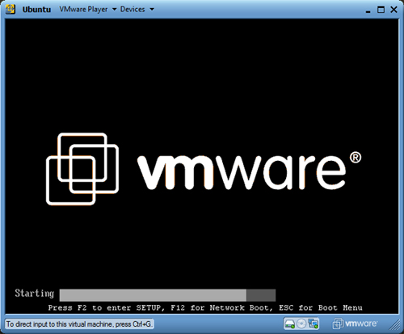
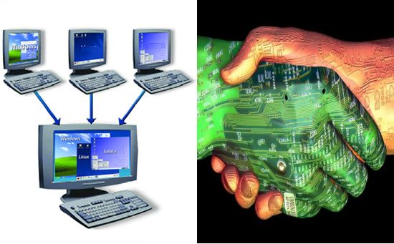
DERECHOS & DISASTER RECOVERY IN WEST VIRGINIA
After the DERECHO, WVNET made a big investment in DISASTER RECOVERY – NetApp Storage Devices and Cisco UCS Blades. MOUNTWEST CTC has virtualized all 12 of their servers as VM’s on blades at WVNET. K12 has spun up their 1st VMs.
“From the dawn of civilization until 2003, humankind generated give exabytes of data. Now, we produce five exabytes every two days.”
— Eric Schmidt, Executive Chairman, Google

Slide 8
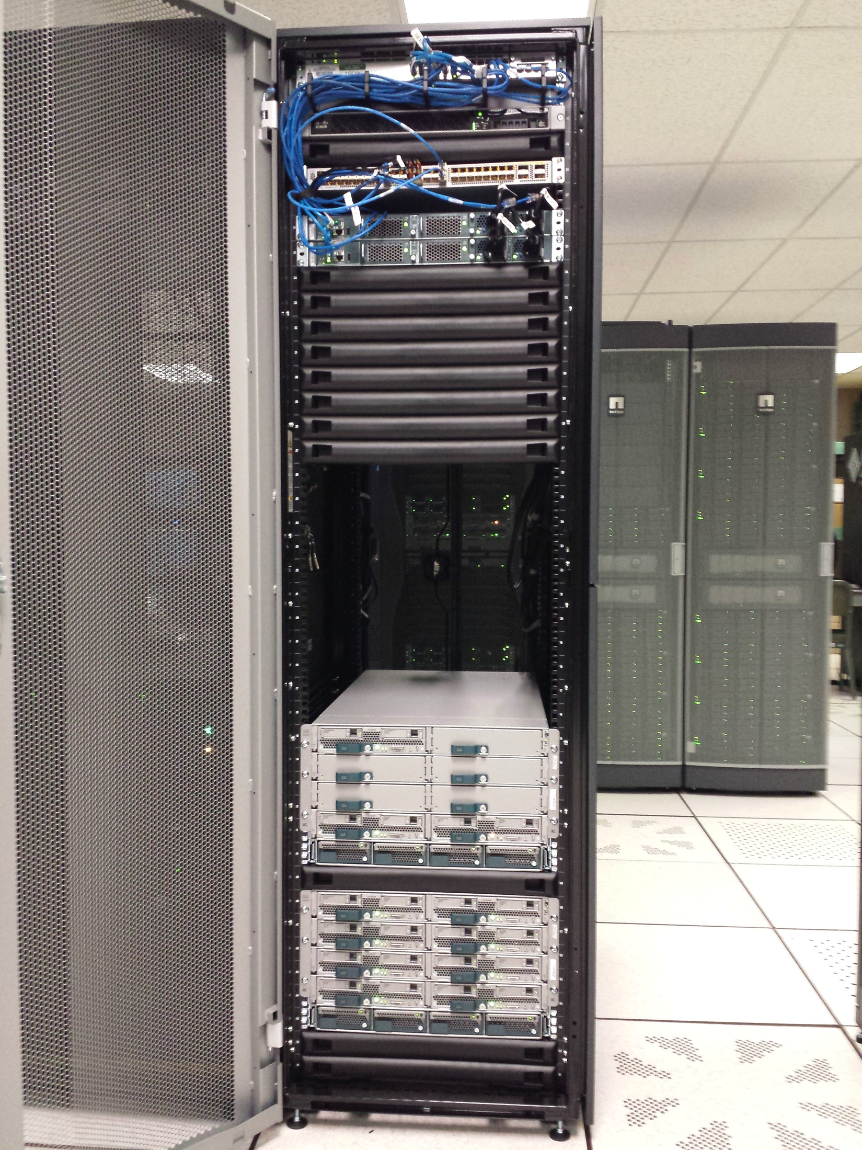
FIRST CISCO EXO-GENI RACK

Slide 9
IMPLEMENTING SDN MOOC

Slide 11
QUESTIONS?????????

