Slide 1
Securing the Human
Security Awareness Program
Notes:
Welcome to Securing the Human, creating an effective security awareness program.
For those who don’t know me: Introduction and background

Slide 2
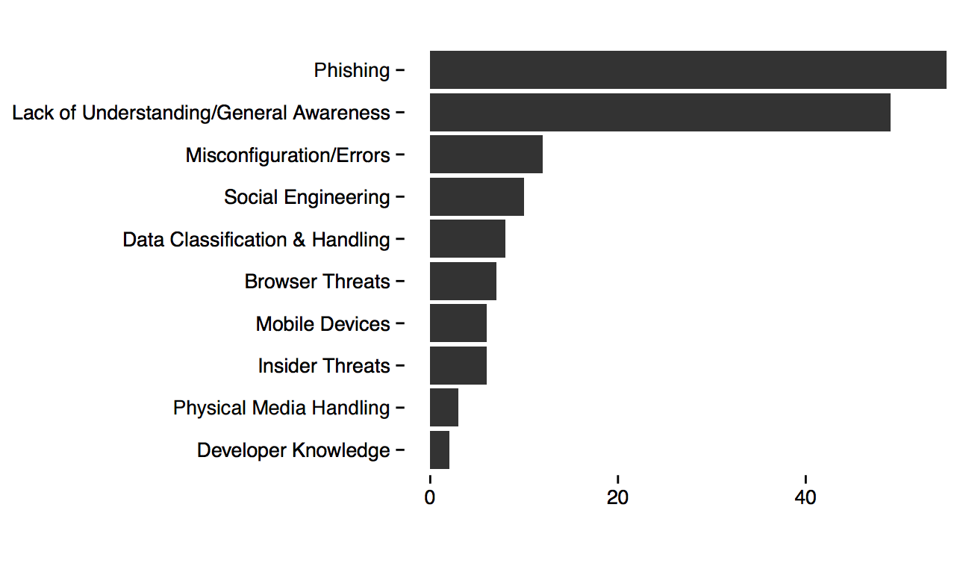
Why Is Security Awareness Important?
Notes:
Get responses to this list. Get people talking.

Slide 3
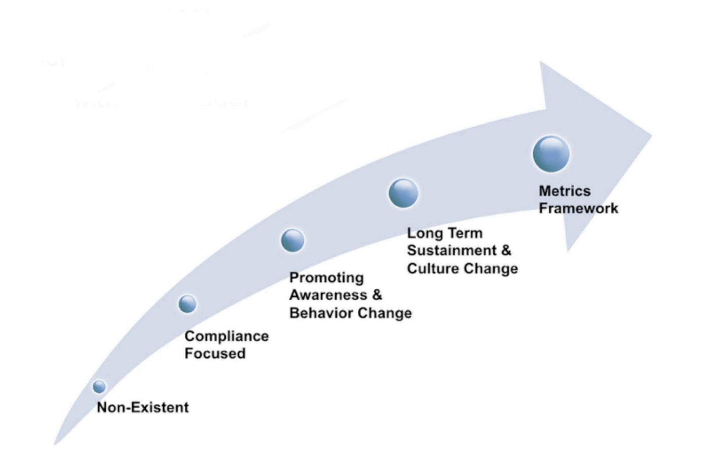
How Mature Is Your Awareness Program?
Notes:
The assumption is that, if you are attending this training it is because you need to implement a security awareness program or because you already have one and want to improve it.
By the raise of hands let’s see where we stand.

Slide 4
How Do You Compare to Similar Organizations
Notes:
These are the industries most likely to attend this conference. How do you compare.

Slide 5
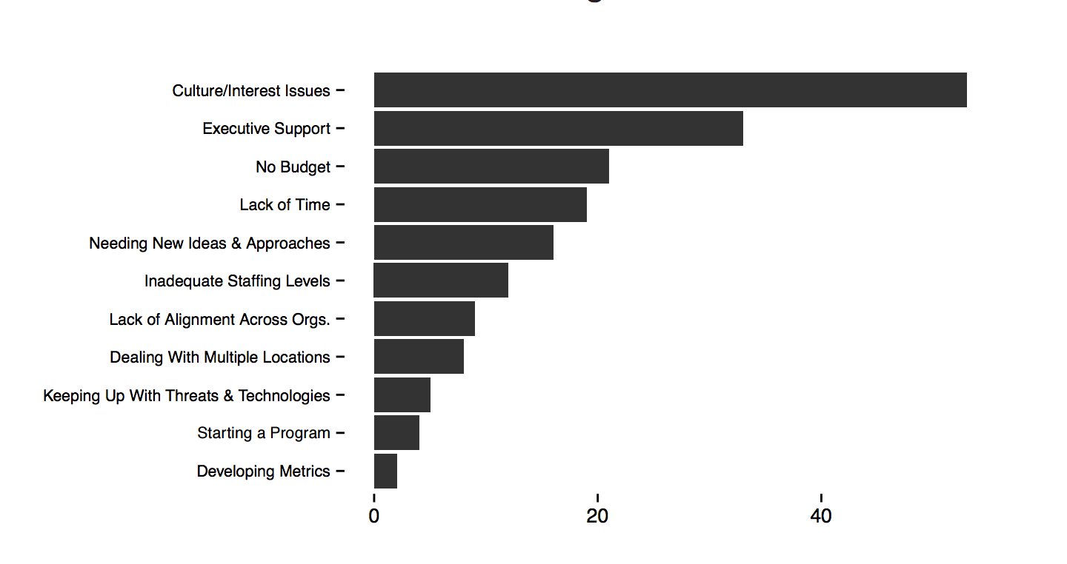
What Are Your Greatest Challenges?
Notes:
Take a minute to look over this list of challenges. Does this ring true? <Get people talking.>

Slide 6
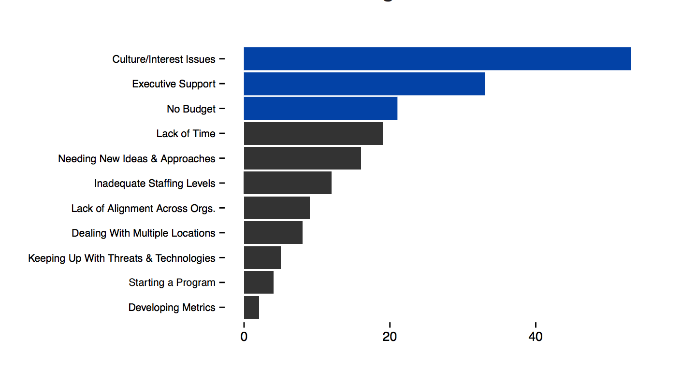
What Are Your Greatest Challenges? Internal Support
Notes:
These top three challenges are all related. How are they related?

Slide 7
Conclusions
Increased Support
Access to Soft Skills
More Time
Bigger Budgets
Notes:
If you have a Security Awareness Program(SAP) and it is failing, or you don’t have one and have been unable to get one started, we can conclude that you have a need for one or more of these 4 things.
Increased Support (From Who?)
Access to Soft Skills(What does this mean?) = The communication barrier between geeks and normal folk.
More Time(Only 24 hrs in a day) = What are we really asking for? = dedicated time to focus on this task.
Bigger Budget(needs no explanation)

Slide 8
Gaining internal Support
Stakeholder Presentation The Human Element Data Breaches Compliance Requirements Your organization may be required to protect certain types of data (card holder, PHI, PII, PNI, etc). Your organization may be required to conduct security awareness training. The Ask.
Here are several sites where you can search records of publicly known data breaches.
https://www.privacyrights.org/
https://blog.datalossdb.org/
http://www.verizonenterprise.com/DBIR/2015
https://securingthehuman.sans.org/media/resources/business-justification/sans-compliance-requirements.pdf
Notes:
Stakeholder Presentation = Create one that allows you to talk about the need for this program with management.
Who has tried to create a Stakeholder Presentation? In hindsight, do you have any tips for the rest of us.
Recommendations: Keep it simple, show specific examples, use statistics, Compare costs, point out compliance obligations, The Ask is essential, this is where you ask for the specific things you will need. Make sure that management understands that the program will not be successful without their full support and cooperation.

Slide 9
You have “Buy In”, Now What?
Notes:
Many times getting “buy in” or “Management Support” Simply means that you have been given the green light to move forward with an awareness program.

Slide 10
Planning Your Security Awareness Program
What Help is Available?
https://securingthehuman.sans.org/media/resources/SecurityAwarenessPlanningKit.zip MGT433: Building High-Impact Awareness Programs
What is most important?
A key step in managing your human risk is to identify, prioritize and then focus on the top risks. https://www.youtube.com/watch?v=OGtTiXyth8g
How can I make it stick? Fogg Behavior Model

Slide 11
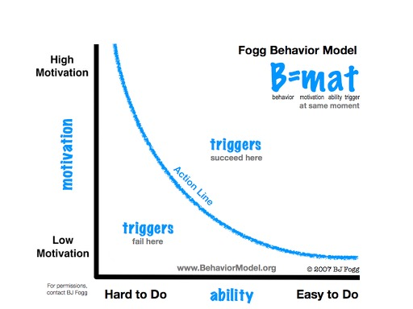
The Fogg Behavior Model
Notes:
The more motivation someone has and the easier it is to do, the more likely they are to exhibit the desired behavior. We tend to focus on the left axis.( i.e. Passwords ) Truth is, most people want to be secure so when they don’t do things in a secure way it is because it is too hard. How can we make password management easier? Password Managers, Two factor authentication. Beware of the curse of knowledge (Your assumption that others know the same things that you know.) Those who know the most about a topic are usually the worst at communicating it to others.

Slide 12
Measuring Results
Focus on just a few high value metrics
Metrics that measure the deployment of your awareness program. How well are we reaching our user base with this program? Use metrics that are actionable, low cost and repeatable.
Metrics that measure the impact of your awareness program. Is behavior changing? Human metrics are assessments; get permission. People have feelings; implement metrics that people like.
https://securingthehuman.sans.org/media/resources/planning/Stage05-01-MetricsMatrix.zip

Slide 13
Questions?
The content for this presentation is almost exclusively taken from Sans.org
https://securingthehuman.sans.org/resources
Contact Info:
~wes furgson UEN Network Security Analyst 801-883-4899

